Slide 1
Studying Language
What’s all these word like thingies mean anyway?

Slide 2
Things to Think About
What was the last thing you said to someone?
Last thing you wrote down?
Last thing you heard?
How exactly did you do all these things?

Slide 3
Say Your Name
Biologically – what did you need to do that?
Brain parts, mouth, tongue, larynx
Cognitively – what did you need to do that?
Something that conveys meaning
Word order
Socially – what did you need to do that?
Knowledge of other users, social rules, attitudes

Slide 4

Everyday…
What daily tasks do you use language for?

Slide 5
Purpose
What is the purpose of language?
Communication
Express emotion
Social interaction
Sounds
Control environment
Record facts
Think
Humor

Slide 6
Language Purpose
What is language’s primary purpose?
Communication – what about when the dog barks to go outside?
Social activity – goal oriented, share ideas
Form of our language shapes our perception and thinking.

Slide 7

Studying Language
Neuropsychology – study of the brain and behavior

Slide 8
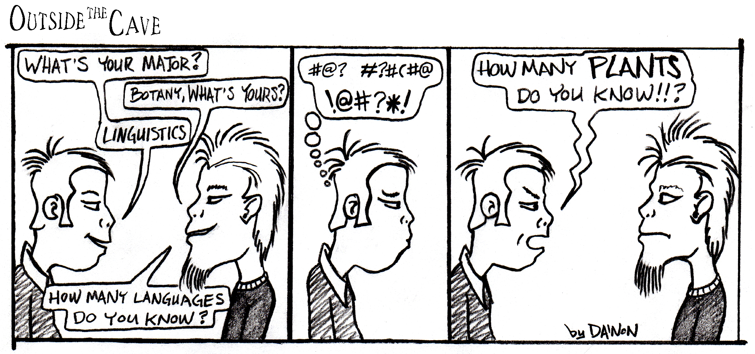
Studying Language
Linguistics – study of language (by itself)

Slide 9
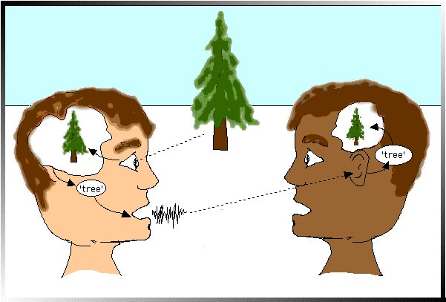
Studying Language
Psycholinguistics – psychological process involved in language or language and the individual

Slide 10
Psycholinguistics
Understanding, producing, remembering language
Reading, writing, speaking, memory
Development, acquisition
Interaction

Slide 11

What is it?
Intuitively – what would you describe language as?

Slide 12
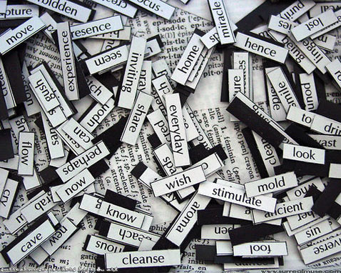
What is it?
Definition – system of symbols and rules that enable us to communicate
Animal language?

Slide 13
What is it?
Let’s break down the definition:
Symbols – what are the symbols that we use?
Do they have to be written?
Are words our only symbols?

Slide 14
What is it?
Rules – what are some of the rules?
Definition – how the symbols are formed to make meaning.

Slide 15
Terms to know
Semantics – study of meaning
Syntax – word order
Morphology – study of words and word information

Slide 16
Terms to know
Morphology
Morphemes – smallest unit of meaning in a word
Inflectional morphology – changes to a word that do not change its underlying meaning
Derivational morphology – changes to a word that change the underlying meaning

Slide 17
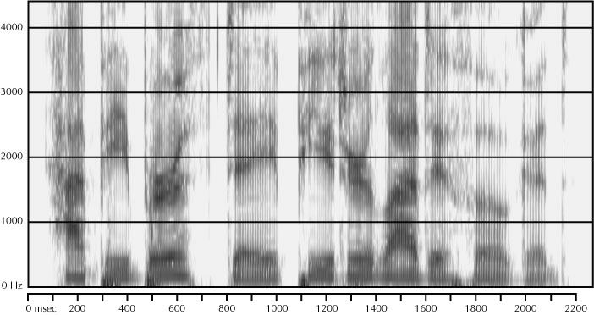
Terms to know
Pragmatics – study of language use
Phonetics – study of sounds
Phonology – study of how sounds are used within a language

Slide 18
Words!
Definition?
A unit of language
Smallest unit of grammar that can stand alone as a complete utterance separated by spaces in language

Slide 19
Words!
There are several levels to understanding words
Sounds – phonemes > morphemes > words
Letters
Syllables

Slide 20
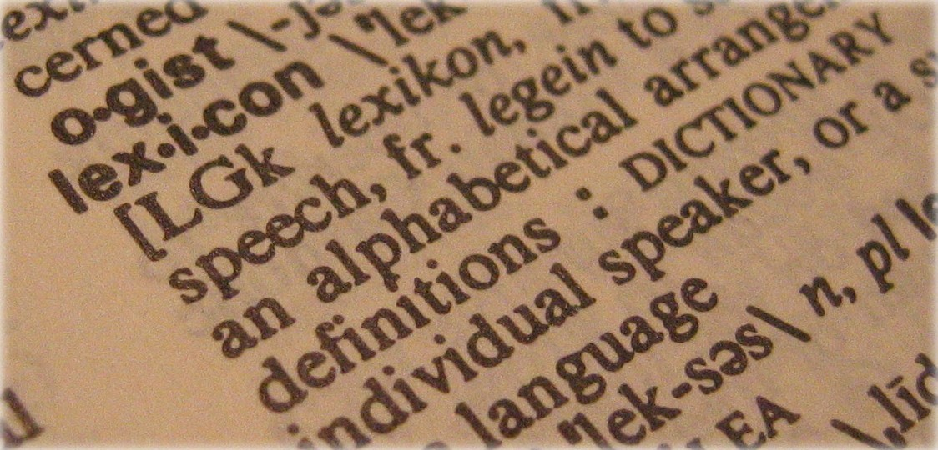
Words!
Lexicon – mental dictionary, word storage
Contains all we know about words, phonology, semantics, orthography (looks), rules
How many words do you know?

Slide 21

Language Change
What new words can you think of that have been added in your lifetime?
What words have we dropped from our language?
How many language are there out there?
Where do we trace English to?

Slide 22
History
Who comes to mind when you talk about studying language?

Slide 23
History
1879 – Galton studied word associations
1895 – studied slips of the tongue
1901 – Freud – origin of speed errors
1951 – Cornell – conference described as psycholinguistics first time

Slide 24
History
Most people start with:
1959 – Chomsky language and transformational grammar
1960s – Chomsky versus Skinner
Chomsky reviewed Skinner’s book Verbal Behavior to show that behaviorism could not account for natural creative language.

Slide 25
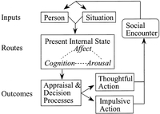
History
1970 – Language as the cognitive processor approach
Now – Boxology – models of language that are box and arrows

Slide 26
Linguistics v Psychology
Old linguistics – comparative linguistics – comparing and tracing origins of different languages
Studying the structure of different languages, discovering them.
New Linguistics – what is and is not acceptable sentence

Slide 27
Linguistics v Psychology
Psychology – a basic human processor of language
Information theory – emphasizes probability and redundancy in language
What would you fill into this sentence?
I went to the bank to deposit my _______?
Still very important today – expectancy and frequency are some of the predictors in language

Slide 28
Linguistics v Psychology
Psychology
Behaviorism – S > R pathways, conditioning and reinforcement control language
Very popular idea for language

Slide 29

AI influence
A lot of research was/is performed to program computers to process language in the way we do.
However, success is very limited
Examples:
Eliza, Parry, SHRDLU
Can you think of examples from
TV/Movies?

Slide 30
AI influence
Connectionism – aka parallel distributed processing, neural networks
Computer simulation with many simple processing units like neurons that learn statistical regularities
Activation – the amount of energy possessed by something, spreading activation

Slide 31
Methods
Computer modeling
Observation
Experimental design
Priming – a target item is processed differently because of previous processing of a related item
Priming can help or hurt you – it mostly helps

Slide 32
Methods
Experimental Design
Semantic priming – word related priming, where the second related word is processed faster because of it’s previous activation
Response times – most common variable measured

Slide 33
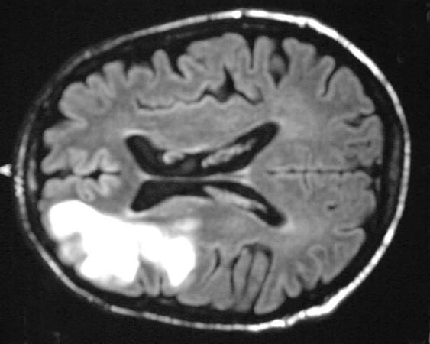
Brains!
Lesion studies – how does brain damage effect performance?
Before the advent of technology, this was the only way to study the brain functions of certain areas
What are some of the areas associated with language?

Slide 34
Brains!
One problem with all the research on lesion studies:
Focuses on where things occur in the brain
And not how it’s related to other parts of why it works the way it does

Slide 35
Brains!
Double dissociation – a pattern of results where one patient can do one task, but not another and the other patient shows the reverse problem
This pattern will show what areas do what, that there are different pathways

Slide 36
Brains!
Neuroimagining – the ability to examine the brain while normal processing is occurring
What’s the problem?
Expensive
Time versus place
Subtraction rules

Slide 37

Brains!
CAT
PET
fMRI
Optical Imaging
EEG/ERP
TMS

Slide 38
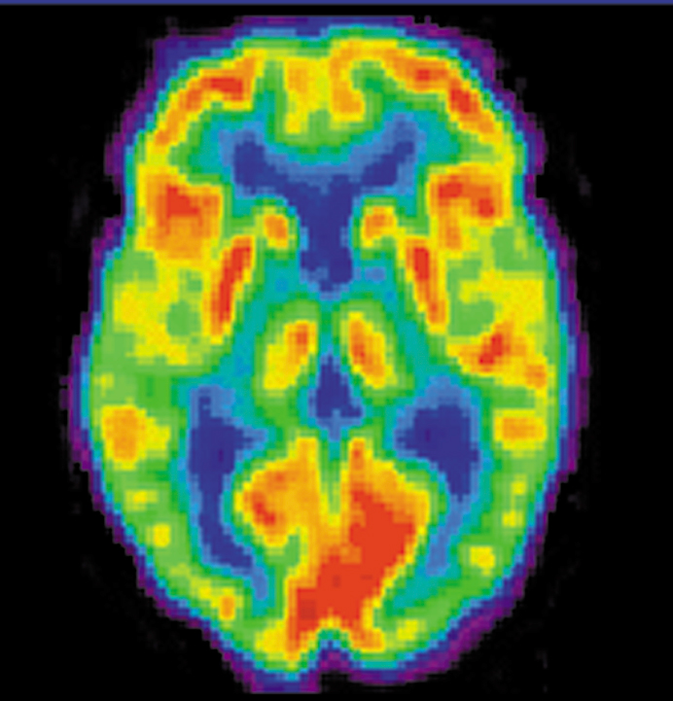
Brains
Pet scan

Slide 39
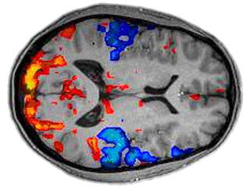
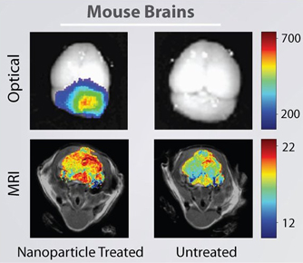
Brains
fMRI

Slide 40
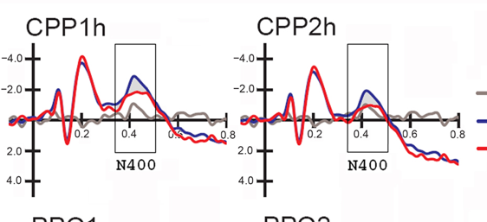
Brains
EEG/ERP

Slide 41
Goals of Psycholinguistics
Processing involved in producing and understanding language
What language processes are related to each other?
Modularity – are these language specific or general cognition
Nature versus Nurture
Multiple languages

